Slide 1


Intro to the Microsoft SecretManagement Module
Mike Kanakos

Slide 2




> whoami
Employer: Invisalign
Twitter: @MikeKanakos
Website: www.commandline.ninja
User Group: www.rtpsug.com
GitHub: https://github.com/compwiz32

Slide 3
Today’s Agenda
SecretManagement Module Overview
What is it?
Partner modules
How they work together
Everyday Secrets Usage
Install & Config
General Use
Azure KeyVault
Basic overview
Link to files: https://github.com/compwiz32/Presentations

Slide 4




How the SecretMgmt module works
1Password Module
U: DAdmin P: ******
U: EAdmin P: ******
U: Mike P: ******
Microsoft SecretStore Module
Microsoft SecretManagement Module
AZKeyvault Module
Console

Slide 5
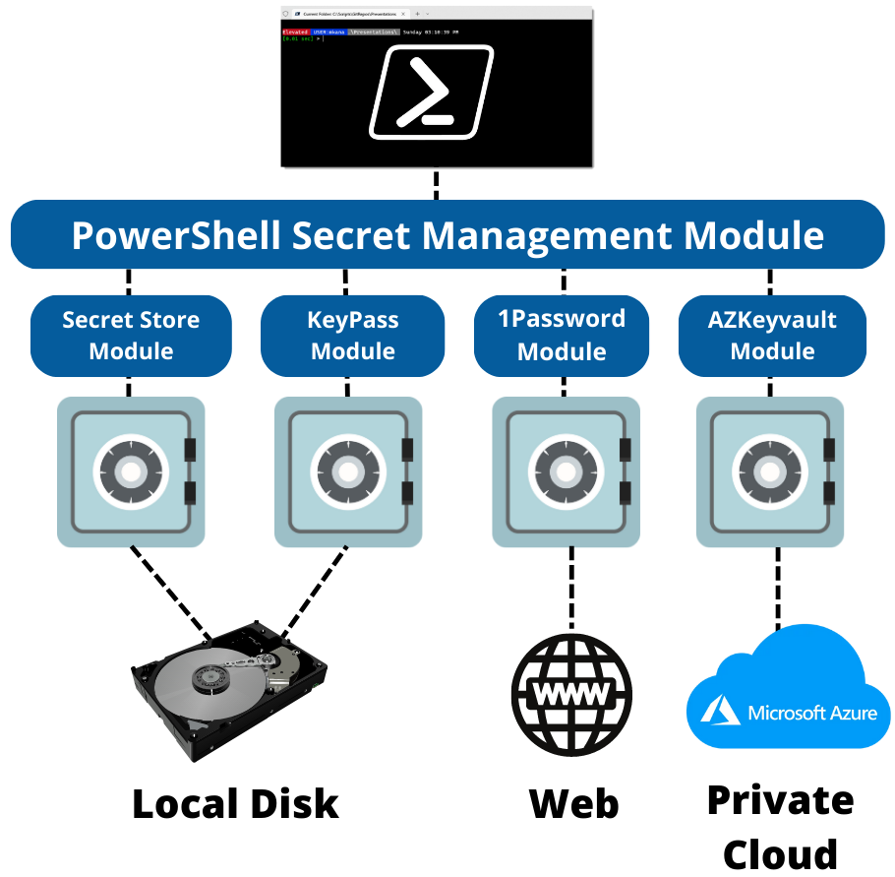
Secret Management Architecture

